Slide 1
5th Grade Parent Orientation 2018-2019

Slide 2
Introductions
Policy handbook
contains information covered this evening
contains contact information
Is available on the website
Website:
www.roosevelt5thgrade.yolasite.com
Roosevelt.usd489.com
www.usd489.com

Slide 3
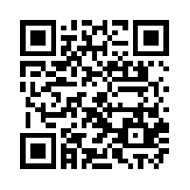
Website: QR Reader:
www.roosevelt5thgrade.yolasite.com i-nigma

Slide 4
Departmentalizing
Home room-writing and reading workshop
5A Miss Gower—social studies
5B Miss Hecker—history
5C Mrs. Dinkel—English language arts
Teacher will be assigned—math
Schedule in back of handbook

Slide 5
Grade Cards
Sent home each 9 weeks/sign and return
No midterms will be sent
Check Power School

Slide 6
Homework Policy
Homework is due the day after it has been assigned.
Late work is docked 10% a day and is a zero after 3 days.
Students will earn recess when work is complete.
Take advantage of homework room.

Slide 7
Agenda/Take-home Folder
Promotes Responsibility
Agenda
Signed each Thursday night by parent
Teachers will check on Fridays
Take-Home Folder
Clean out every night

Slide 8
Schedule
Orchestra—
Tuesday (7:30-8:00)
Thursday (3:00-3:45)
Special Choir—Info to come
Library—Thursday and Friday
Counseling—2 times each month

Slide 9
Birthdays
Students may bring treats. (Peanut-free school)
Half Birthdays are celebrated.
June in January
July in February
August in March

Slide 10
Visitors
When you visit, please check in at the office.
Cell phones
Cell phones must remain in book bags till school is out.
Cell phones policy is in
the Roosevelt Handbook.

Slide 11
Behavior Policy
We have high expectations for fifth graders as the leaders in our building.
Appropriate choices will result in participation in special classroom activities each month.
Inappropriate choices may result in loss of recess, loss of tickets, notes home, office referrals, and possible
in-school suspension.

Slide 12
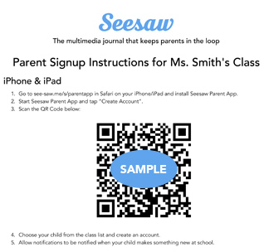
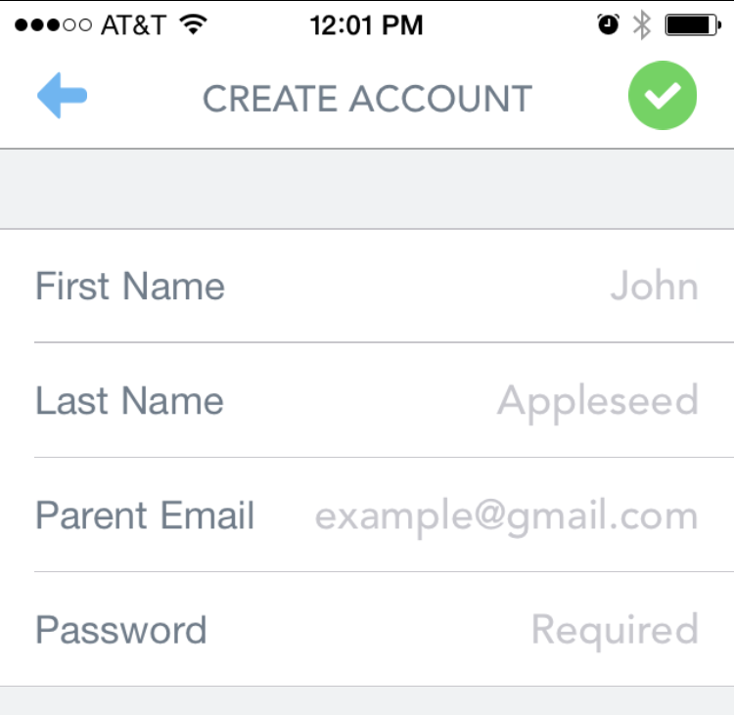
Now let’s sign up!
Search for “Seesaw Parent Access” in the iTunes App Store, Google Play Store or Kindle Fire Store and download the app.
2. Tap “Create Parent Account”* and scan the QR Code on the handout.
3. Create your account. Allow notifications to get real-time updates and check out what’s in your child’s journal.
*If you already have an account, just sign in to your account, and choose “+Add Journal” from the left menu.
Notes:
Use this slide if you’re sharing this presentation with parents in person, like at Back to School Night, and have your parent invite handouts printed out. Parents can sign up right there - it just takes a minute!

Slide 13
Wrap-up
Remember to sign in.
Please sign up for a party.
Be sure to sign the request sheet if you need a printed copy of the 5th Grade Policy Handbook.

